Slide 1
USER PERSONAS
TEAM 4

Slide 2

User Persona
Name and Picture
Characteristics
Need
Age - 25
Occupation - Marketing Manager
Gender - Male
Location - Miami
Income - $4500 per month
User Profile - Sergio works at a digital marketing agency. He is tech-savvy and enjoys using his smartphone to browse social media, and shop online. He is also very fashion-conscious and enjoys dressing up for work and social events.
Sergio wants to be able to simply put together new outfits that match his style and to have a large selection of clothing alternatives to pick from.
He wants to be able to effortlessly incorporate new fashion trends into her outfit since she likes learning about them.
Sergio Ramos
Who
Why
Notes:
Types of User -
Student
Corporate sending employee on business trip
Travel Vlogger
Person booking a vacation for family - (specify no. of people)
Person booking a vacation with friends
Corporate employee recreational trip
Professor taking his students on a study tour
Destination Wedding
Hiking Leader (plan the route)
Wildlife Photographer

Slide 3

User Persona
Name and Picture
Characteristics
Need
Rachel is seeking for an app that provides both fashionable and business-casual attire for conferences and gatherings, as well as cozy and practical apparel for use at the office.
She likes attire that is simple to put on and comfortable so that she may concentrate on her work without being distracted by her apparel.
Rachel like adaptable apparel that may be combined with other items to create a variety of looks.
Rachel is a busy professional who wishes she had an app that would make it simple for her to select clothes that fit her needs.
Age - 28
Occupation - Software Developer
Gender - Female
Location - New York
Income - $8000 per month
User Profile- Rachel is a software developer at Google who works from home. However, she has to attend meetings with client and social gatherings. She like to dress up and stay up with the trend.
Rachel Aniston
Who
Why
Notes:
Types of User -
Student
Corporate sending employee on business trip
Travel Vlogger
Person booking a vacation for family - (specify no. of people)
Person booking a vacation with friends
Corporate employee recreational trip
Professor taking his students on a study tour
Destination Wedding
Hiking Leader (plan the route)
Wildlife Photographer

Slide 4
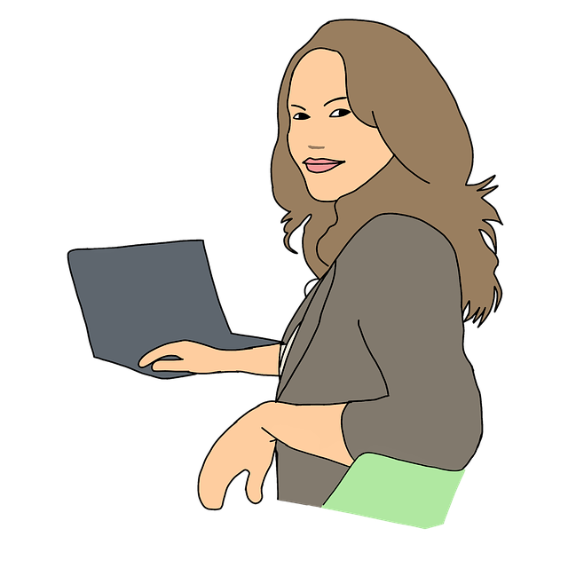
User Persona
Name and Picture
Characteristics
Need
Jennifer seeks to book an all-inclusive vacation for her and her four friends.
For social engagements, Jennifer prefers apparel that is adaptable and can be easily changed from daytime to evening wear.
She is looking for clothes that are simple to maintain and can survive repeated washing and wearing.
Jennifer appreciates showcasing her personal flair on social media and welcomes comments.
Age-30
Occupation: Homemaker
Gender- Female
Location-Philadelphia
User Profile -Jennifer is a housewife who prioritizes comfort and adaptability in her attire. She spends most of her time at home. She wants to seem fashionable and put together while wearing clothes that are useful for her everyday activities and comfy. For social gatherings, she also needs attire that is simple to switch from day to night.
Jennifer Green
Who
Why
Notes:
Types of User -
Student
Corporate sending employee on business trip
Travel Vlogger
Person booking a vacation for family - (specify no. of people)
Person booking a vacation with friends
Corporate employee recreational trip
Professor taking his students on a study tour
Destination Wedding
Hiking Leader (plan the route)
Wildlife Photographer

Slide 5
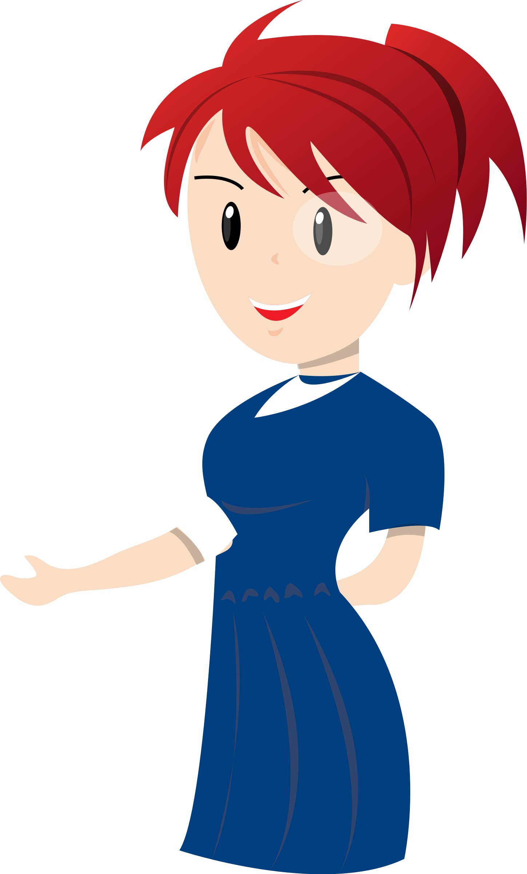
User Persona
Name and Picture
Characteristics
Need
She appreciates fashionable attire that enables her to follow the most recent fashion trends.
Mary is looking for clothes that are both practical and comfortable for her daily schedule of courses, studying, and social gatherings.
She wants to be able to quickly put together fashionable ensembles that stand out for social occasions.
Mary likes showcasing her personal style on social media and welcomes comments.
Age-20
Occupation-College Student
Gender-Female
Location-UConn
Income-$,1000 per month
User profile- Mary is a college student who values affordability and trendy styles in her clothing. She frequently shops at quick fashion retailers since she loves to stay current with fashion trends. With her hectic academic schedule, Mary is interested in apparel that is both fashionable and practical. Also, she likes going to social gatherings and trying to stand out with her clothing.
Taylor Gomez
Who
Why
Notes:
Types of User -
Student
Corporate sending employee on business trip
Travel Vlogger
Person booking a vacation for family - (specify no. of people)
Person booking a vacation with friends
Corporate employee recreational trip
Professor taking his students on a study tour
Destination Wedding
Hiking Leader (plan the route)
Wildlife Photographer

Slide 6
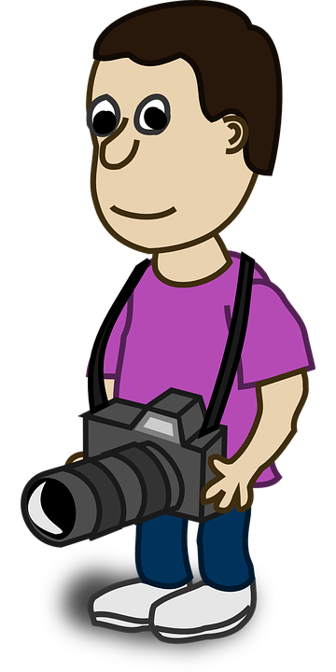
User Persona
Name and Picture
Characteristics
Need
Peter is seeking for an app that provides a large selection of convenient, fashionable, and comfortable clothing alternatives.
Peter wants clothes that can be worn in a variety of situations, such as touring cities or embarking on outdoor excursions.
He is looking for apparel that will hold up to regular use and travel.
Peter is active on social media and solicits comments and conversation about his personal style and wardrobe from his fans.
Age - 28
Occupation - Travel Vlogger
Gender - Male
Location - Houston
Income - $6000 per month
User Profile- As a travel vlogger, Peter spends the majority of his time exploring new places and producing video for his subscribers. He looks for attire that is both practical and fashionable because he has to appear good on camera and be mobile while on the road. Peter wants clothes that can be worn in a variety of situations, such as touring cities or embarking on outdoor excursions.
Peter Hughes
Who
Why
Notes:
Types of User -
Student
Corporate sending employee on business trip
Travel Vlogger
Person booking a vacation for family - (specify no. of people)
Person booking a vacation with friends
Corporate employee recreational trip
Professor taking his students on a study tour
Destination Wedding
Hiking Leader (plan the route)
Wildlife Photographer

Slide 7
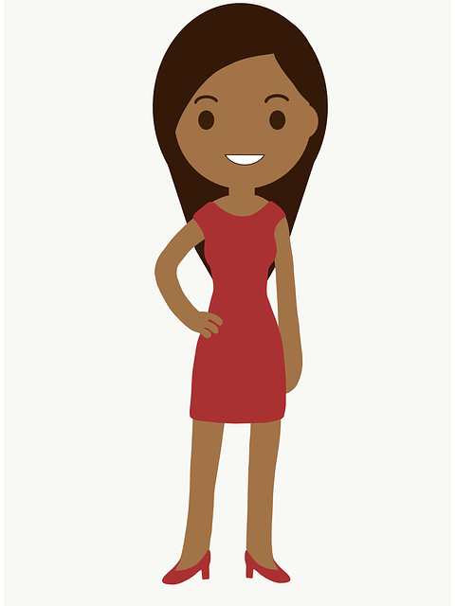
User Persona
Name and Picture
Characteristics
Need
Age - 35
Occupation - Business Executive
Gender - Female
Location - New York
Income - $10000 per month
User Profile- Olivia is a busy professional who values efficiency and convenience. They frequently go to business meetings and formal gatherings and have a great job. Olivia is prepared to spend money on high-quality, fashionable, and professional attire because she wants to leave a good impression. People are drawn to timeless looks that work well in many different contexts.
Olivia is searching for an app that provides alternatives for high-quality, business-casual attire that are adaptable and can be worn in a variety of scenarios.
They respect convenience and do not have much time to browse through various shops or websites. They desire an app with simple search and filtering options.
Olivia is interested in ethical and sustainable production methods and is ready to spend money on durable items.
Selena Swift
Who
Why
Notes:
Types of User -
Student
Corporate sending employee on business trip
Travel Vlogger
Person booking a vacation for family - (specify no. of people)
Person booking a vacation with friends
Corporate employee recreational trip
Professor taking his students on a study tour
Destination Wedding
Hiking Leader (plan the route)
Wildlife Photographer

